Slide 1

SAP BTP ABAP on Cloud / RAP Training
DAY-08
Anubhav Oberoy
www.AnubhavTrainings.com
Follow excellence with sheer passion

Slide 2


DISCLAIMER
The training content and delivery of this presentation is confidential, and cannot be recorded, or copied and distributed to any third party, without the written consent of Anubhav Trainings

Slide 3

01
Unmanaged RAP
02
Attachments
03
Analytic Use Case
Notes:
https://pixabay.com/photos/san-francisco-transamerica-pyramid-1633203/

Slide 4
Reference Scenario – Unmanaged Impl.
Imagine in our company we had written all the business logic in the past ourself in form of FM, Classes. Today we want to reuse our old code which has the business logic, validation, sequence, processing, along with transaction buffer. So if you want to manage all these codes yourself and integrate your legacy (old code written by you or your team), you will opt for unmanaged (here RAP is not managing the CURD operation) scenario.
SAP is providing a demo class for learning purpose viz. /dmo/cl_flight_legacy
In this class we have our own old logic which contains the transaction buffer and business logic to maintain all the source code to interact with database ourself.
The RAP framework allows us to implement the entire runtime of the BO
Interaction Phase (code to interact and keep data inside itab)
Transaction Buffer (like a internal table where we keep temporary data)
Save Sequence (Commit work and Rollback)
UPDATE_BAPI
(LUW)
BAPI_TR_COMMIT
BAPI_TR_ROLLBACK
www.anubhavtrainings.com

Slide 5
Development Flow
Serv Impl.
BIMP-unmanaged
Serv definition
BDEF - unmanaged
Travel_U
Travel_U_MDE
Agency
Customer
agency
customer
/dmo/travel
www.anubhavtrainings.com

Slide 6
Title
<>
How you know in the code which fields are changed on the screen by the user.
So accordingly we can update the data into the database only for the changed fields??
RAP provides a compiler structure called %control which will tell us what fields were changed on UI.
We need to tell the RAP, what will be the datatype for the control structure.
*
*
*
www.anubhavtrainings.com

Slide 7
Booking Consumption Analytics View
Booking Analytics CDS entity
Travel Analytics CDS entity
Carrier
Connection
/dmo/travel
/dmo/customer
/dmo/agency
Bookings

Slide 8
ALP Analytic List Page
An Analytical List Page (ALP) is a SAP Fiori element that allows users to analyze data and take action on it. It's a key component of SAP Fiori embedded analytics.
Here are some things you can do with an ALP:
Analyze data: Use KPIs, charts, tables, and visual filters to analyze data from different perspectives
Investigate root causes: Drill down to find root causes
Act on transactional content: Take action on transactional content
Build apps: Create apps that visualize and report data
Combine data: Combine transactional and analytical data using charts and tables
ALPs have a flexible layout that can be customized in a number of ways, including:
Sorting: Sort the work list
Page layout: Set page layout preferences
Filters: Set filters and save filter selections
Default views: Set default views
ALPs are organized into two sections: a header section for setting filters, and a content section for displaying charts and lists.
www.anubhavtrainings.com

Slide 9
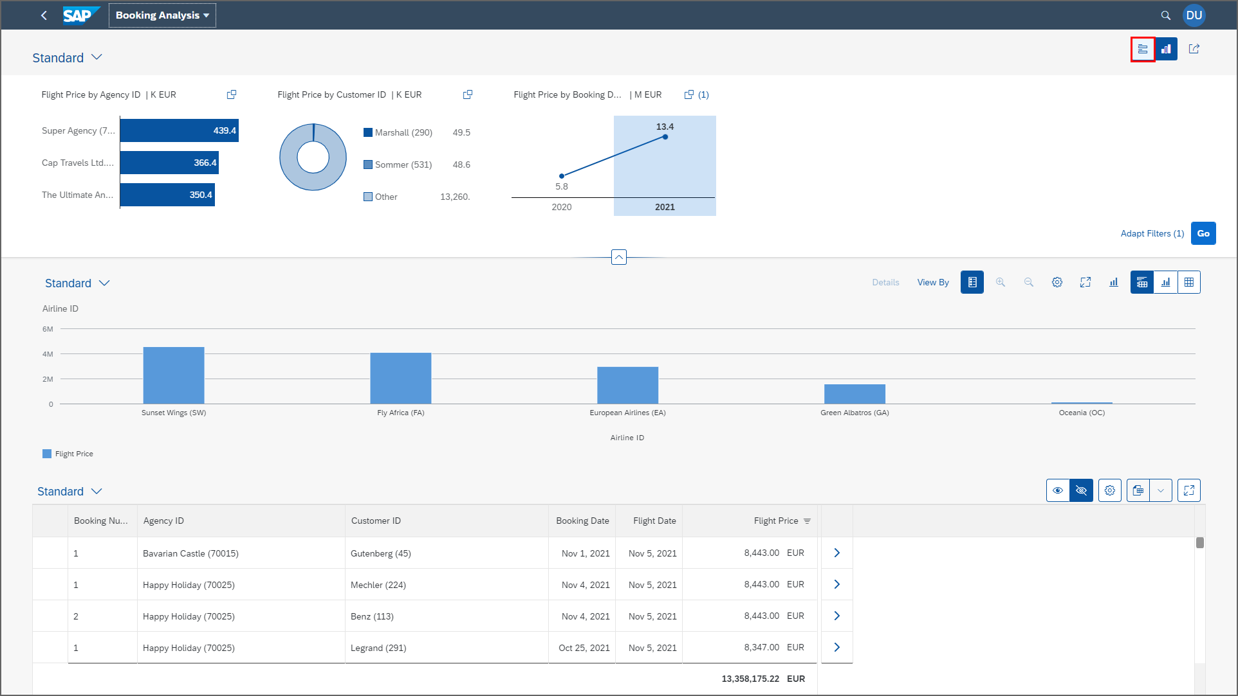
ALP
www.anubhavtrainings.com

Slide 10
www.anubhavtrainings.com
Thank You
End of Day 08
www.anubhavtrainings.com

Slide 11


We’re committed to empower you to be
#FutureReady
through powerful training solutions.
We build the workforce of the future.
250+
Corporate Clients
30,000+
Learners Trained
25000+
Learners Placed
FREE WEBINARS
Sign up for free webinars with industry experts every fortnight!
Enroll Now!
Contact us today!
https://anubhavtrainings.com

